Slide 1
http://www.bing.com/videos/search?q=water+and+water+fall&&view=detail&mid=72A41E873254C05ABA0672A41E873254C05ABA06&&FORM=VDRVRV

Slide 2
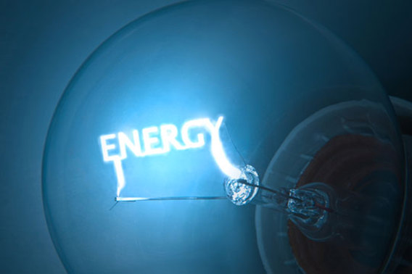

Slide 3
Energy On Earth Exist in 6 Forms…
Mechanical
Electromagnetic
Heat (Thermal)
Chemical
Nuclear
Electrical

Slide 4
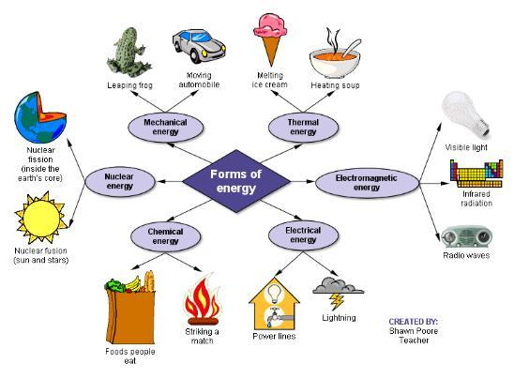

Slide 5
Mechanical Energy (Kinetic)
Mechanical Energy is the energy of moving parts and action.
Examples include:
- walking, riding a bike, machines,
wind, moving water.

Slide 6
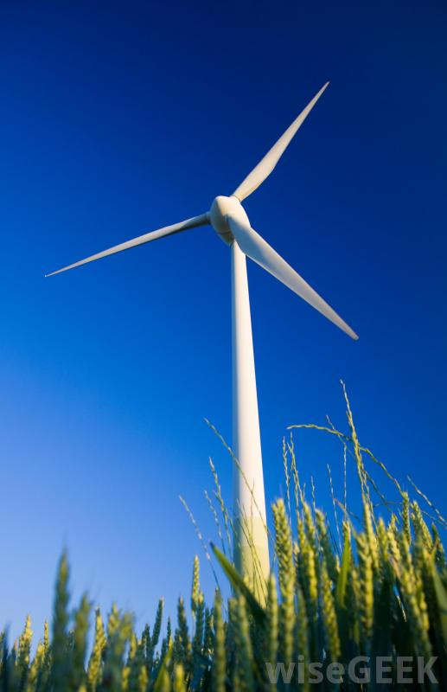
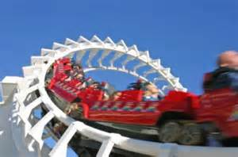
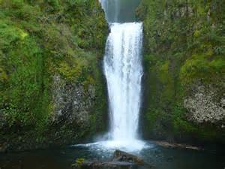
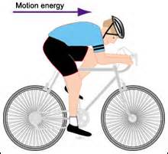
Mechanical Energy

Slide 7
Electromagnetic Energy
Electromagnetic Energy is energy from the Sun.
Examples include:
- radios waves, light waves, infra-red waves

Slide 8
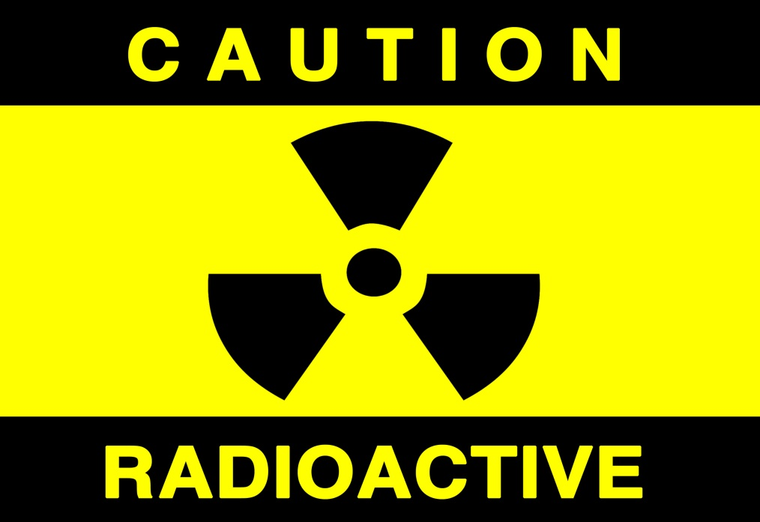
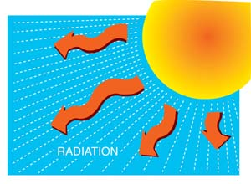

Slide 9
Electrical Energy
Electrical Energy is energy caused from the movement of electrons creating an electric charge.

Slide 10
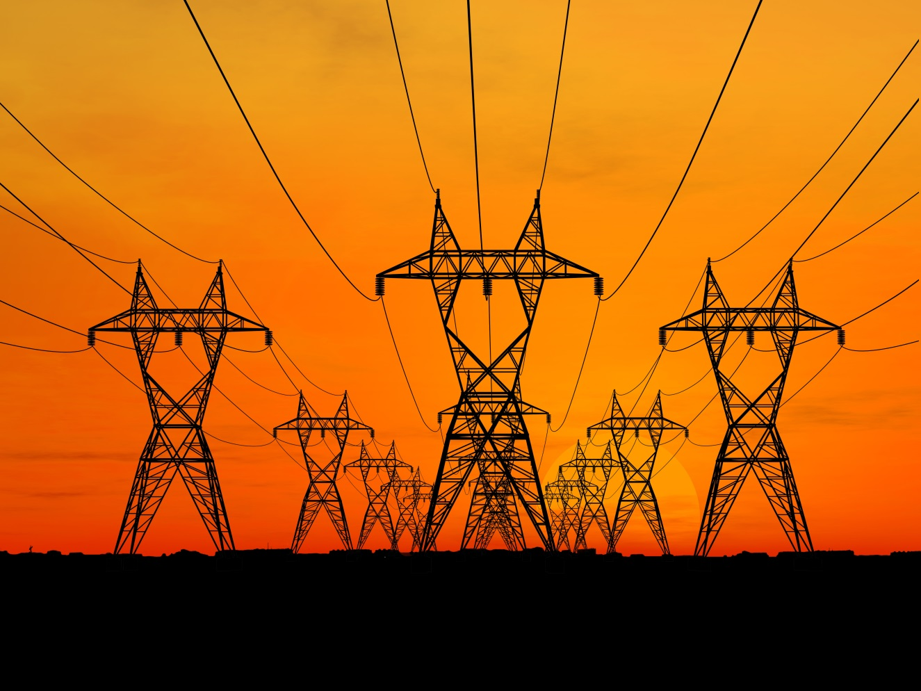
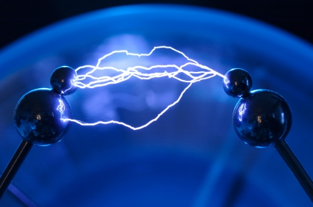

Slide 11
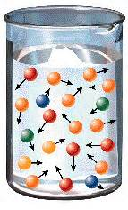
Heat Energy (Thermal)
Heat energy is created when particles within a substance move really fast and create heat.
The faster the particles move the more the heat.

Slide 12
Chemical Energy
Chemical Energy is potential energy that is stored within chemicals.
Examples include:
Food, wood, matches, coal, gasoline, photosynthesis in plants, batteries.

Slide 13
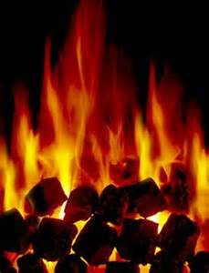
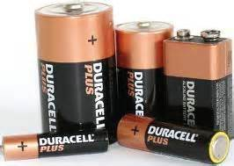
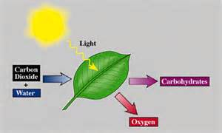
Chemical Energy

Slide 14
Nuclear Energy
Nuclear Energy is the energy stored in the nucleus of the atom. When the atoms are split or combined they release energy.
Examples include:
- nuclear bomb, atomic decay of
atoms.

Slide 15
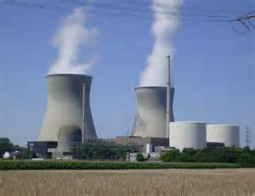
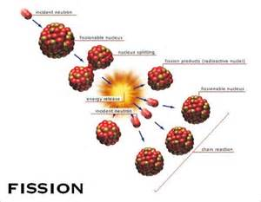
Nuclear Energy

Slide 16
Changing Energy Forms…
The law of conservation of energy states: “Energy cannot be created nor destroyed, it simply changes form.”
To create electricity sometimes the form of energy has to be changed from one form to another so it can be used.

Slide 17
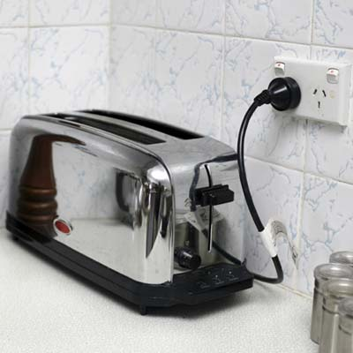
Let’s see if we can name the energy conversions shown below……

Slide 18
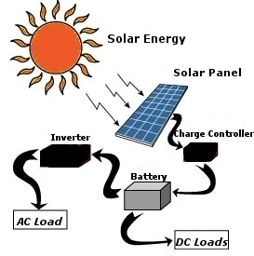

Slide 19
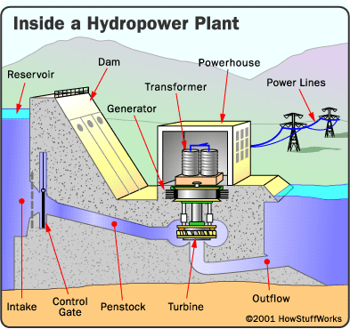

Slide 20
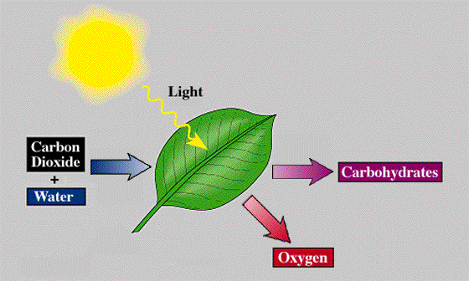

Slide 21
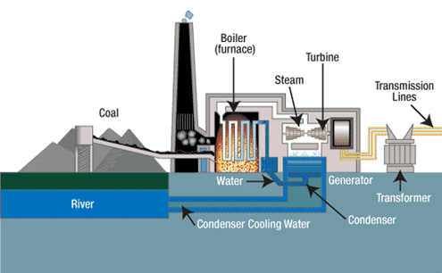

Slide 22
Why do humans create these forms of energy?
Humans have to create energy in the form of electricity to power all of our gadgets that make life fun and exciting.
We create this energy by using natural resources that can Renewable and Non-Renewable.

Slide 23
Renewable Energy

Slide 24
What is Renewable Energy?
Energy that comes from resources (sources) that can be replenished within a human life time (100 years).

Slide 25
Examples of Renewable Energy…
Wind Energy
Hydropower Energy
Geothermal Energy
Solar Energy

Slide 26
Non-Renewable Energy Examples… Resources that cannot naturally be recreated within a human life-time
Coal
Oil
Natural Gas
Nuclear
https://www.youtube.com/watch?v=rEJKiUYjW1E&feature=youtu.be

Slide 27
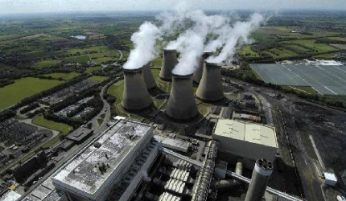
https://www.youtube.com/watch?v=rEJKiUYjW1E&feature=youtu.be

Slide 28
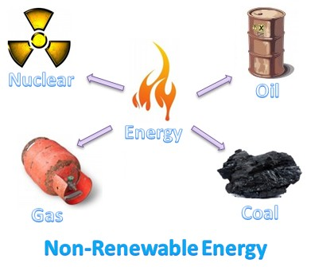
Non-Renewable Resources Video

Slide 29
Why use Renewable and not Non-Renewable?
Renewable resources are much cleaner for the environment. They do not need to burn anything to generate heat. Renewable resources capture the energy of natural elements and convert them to electricity.
Burning fossil fuels (coal, oil) produces harmful gases into our atmosphere.
These harmful gases “trap” heat within our atmosphere thus making our planet warmer.
This trapping of heat is called the “green house effect” and can change our global climate.

Slide 30
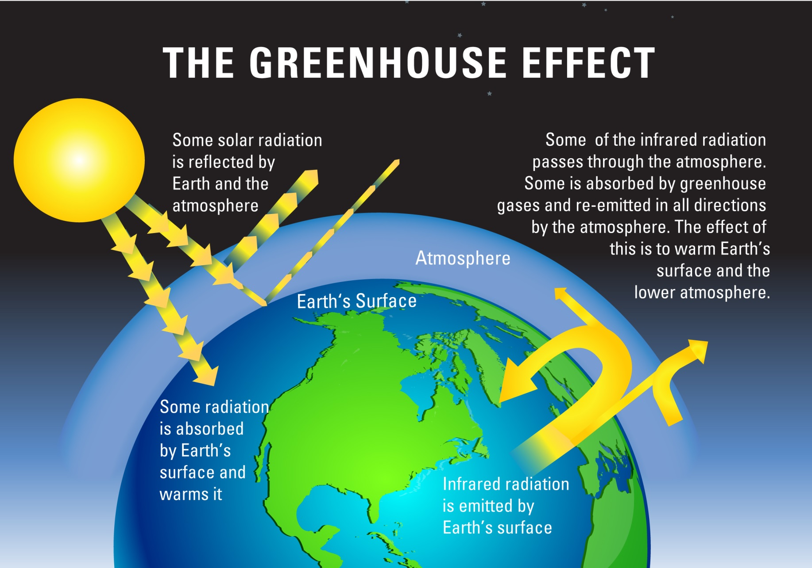
https://youtu.be/BPJJM_hCFj0

Slide 31
Renewable Clean Energy Resources Wind…
When wind is blowing it is in a Kinetic State of energy. This means that it is in a state of motion.
To capture this (movement) energy and turn it into electricity, scientists and engineers created a Wind Turbine to convert the mechanical energy into electrical energy.

Slide 32
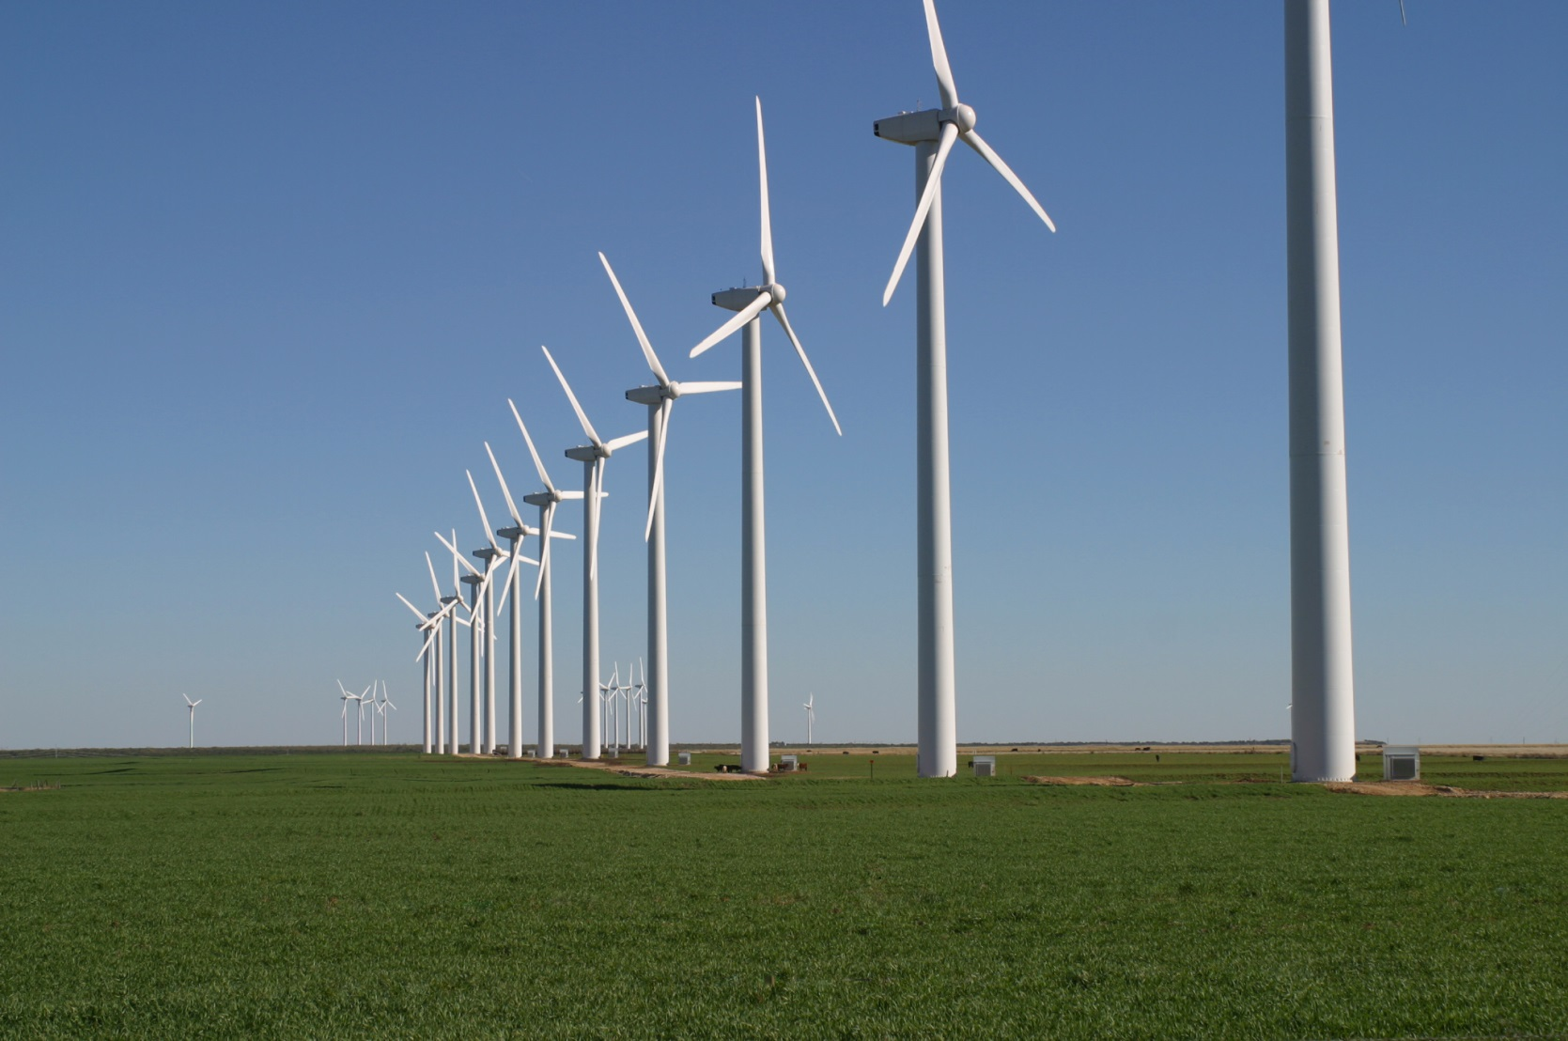
Wind Energy
wind energy - Bing video

Slide 33
Water Energy
When water is flowing in a stream, river, or water fall it has kinetic energy (energy of motion). This energy can be captured by a machine called a turbine and changed from mechanical energy into electricity.

Slide 34
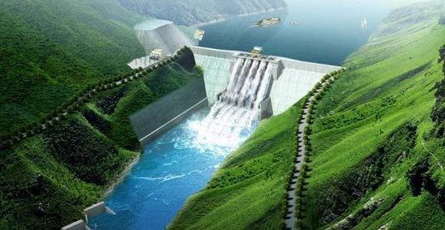
Hydropower
http://wn.com/hydropower_explained

Slide 35
Geothermal Energy
The word geothermal can be broken up into two words:
Geo = Earth
Thermal = Heat
Geothermal Energy is the captured energy from the heat inside of the Earth.
This heat inside of the Earth only exist near places that have volcanos and have magma really close to the surface of the Earth.
The heat from the magma helps to produce steam to spin a turbine and then create electricity.
The thermal energy is converted to mechanical and then electrical.

Slide 36
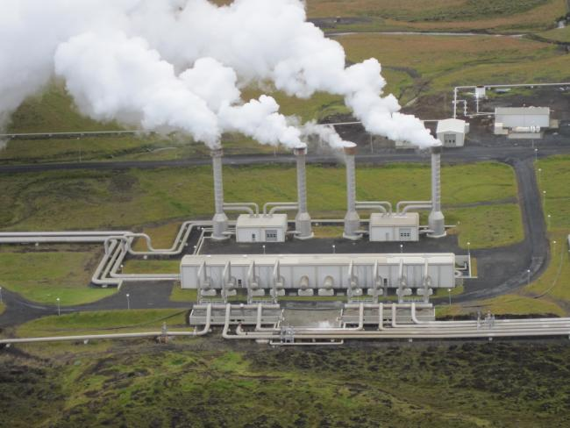
Geothermal
http://www.youtube.com/watch?v=Bl-oxDZDfqI

Slide 37
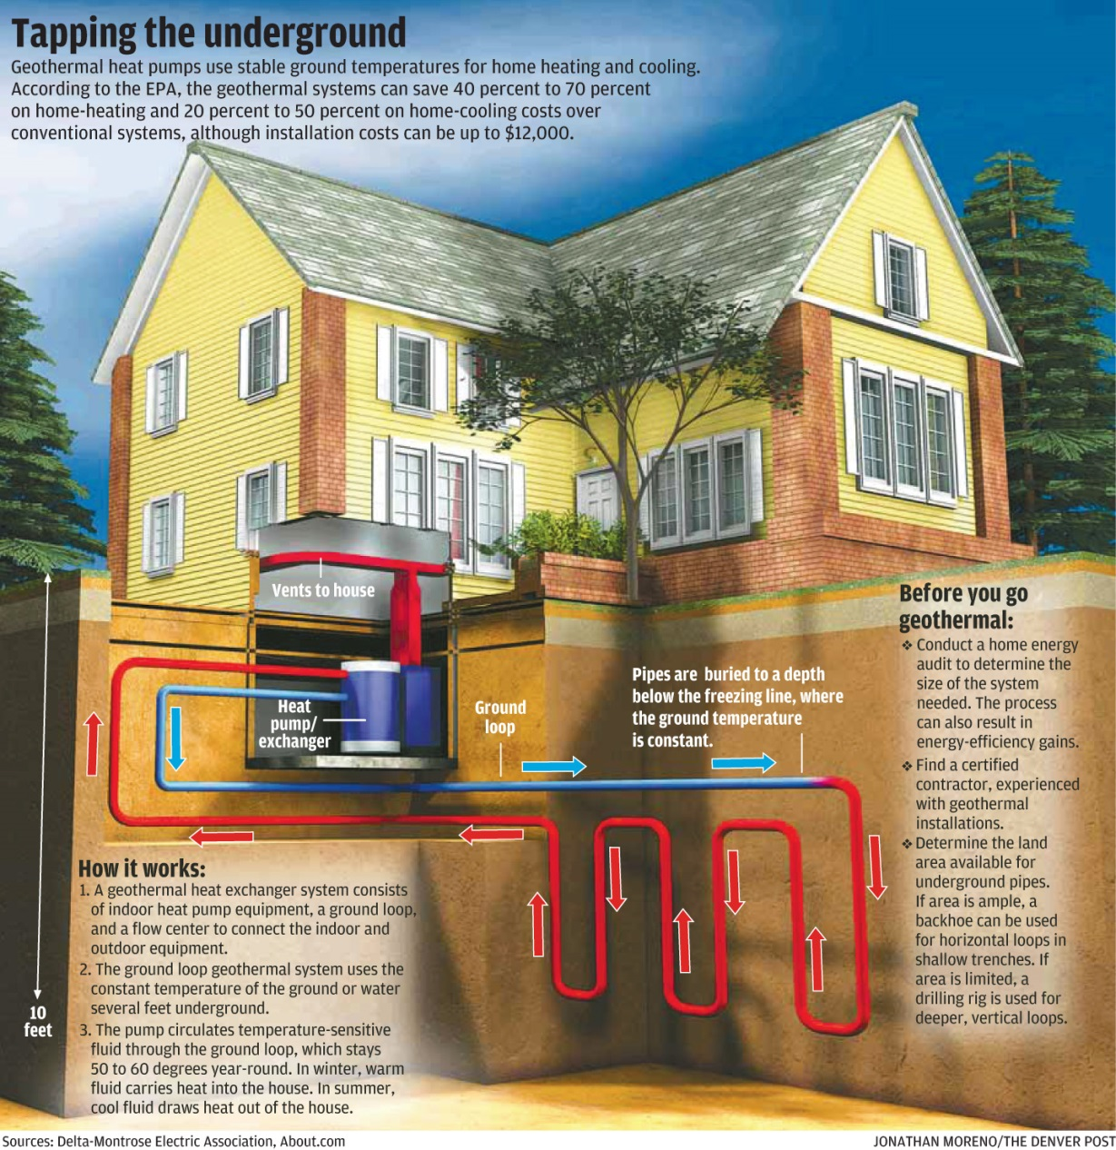
Geothermal in Home

Slide 38
Solar Energy
Solar Energy captures natural sun light which is electromagnetic energy and turns it into electricity that can be used in our homes.

Slide 39
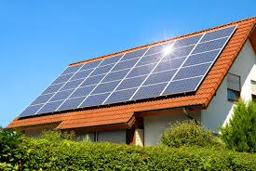
http://www.bing.com/videos/search?q=what+is+solar+power&view=detail&&mid=3239E72E04077678F7A13239E72E04077678F7A1

Slide 40
Which Energy Source Do You Think the World Should Use?
Solar
Wind
Water
Geothermal
WHY?

Slide 41
Good Powerpoints
http://www.bing.com/videos/search?q=how+does+a+solar+panel+work&&view=detail&mid=9A6827382AFA62E22D4A9A6827382AFA62E22D4A&&FORM=VRDGAR
http://www.bing.com/videos/search?q=solar+energy+in+the+mojave+desert&&view=detail&mid=FC9E2237A0C7E36DA813FC9E2237A0C7E36DA813&&FORM=VRDGAR

